Slide 1







Developers Survey
Kalaivani KG
21/08/2022

Slide 2



OUTLINE
Executive Summary
Introduction
Methodology
Results
Visualization – Charts
Dashboard
Discussion
Findings & Implications
Conclusion
Appendix

Slide 3

EXECUTIVE SUMMARY
Current Technology Usage
Top 10 Languages
Top 10 Databases
Platforms
Top 10 WebFrames
Future Technology Trends
Top 10 Languages desired for the next year
Top 10 Databases desired for the next year
Desired platforms for the next year
Top 10 WebFrames desired for the next year
Demographics
Respondent classified by gender
Respondent count for countries
Respondent count by age
Respondent count by gender and classified by education level

Slide 4

INTRODUCTION
This presentation analyze top programing language, top Database skills in demand, top platforms and top Web frame used.
Also it analyze the future trend as well.
Correlation between numerical data
The popular IDEs

Slide 5

METHODOLOGY
The source of the data for the presentation is from m5_survey_data_demographics.csv and m5_survey_data_technologies_normalised.csv.
Visual representation is created using Cognos Dashboard Embedded(CDE)

Slide 6
RESULTS

Slide 7
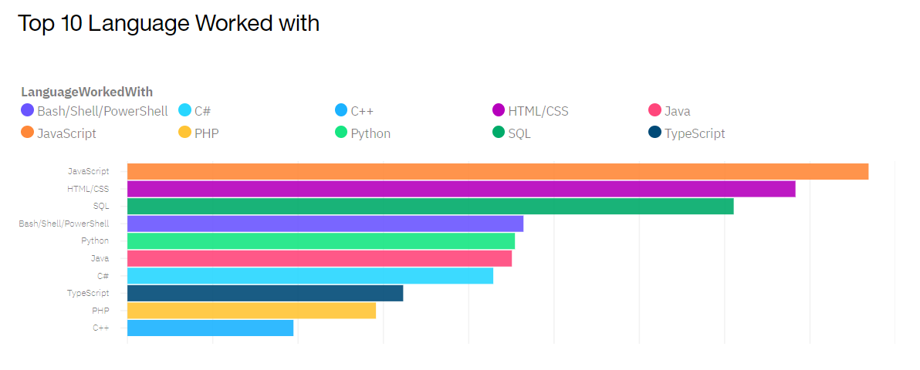
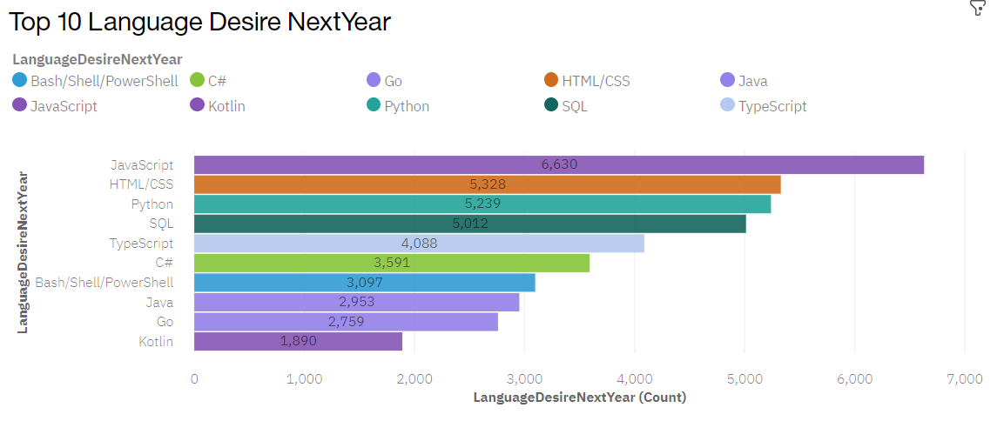
PROGRAMMING LANGUAGE TRENDS
Current Year
Next Year

Slide 8
PROGRAMMING LANGUAGE TRENDS - FINDINGS & IMPLICATIONS
Findings
Javascript is the most popular language to use in current as well as in future
HTML/CSS is the second popular language in current and also in future.
Python is the raising language
Implications
Javascript and HTML/CSS both have demand in current and future
Python is new trend for future and need to focus on it.
C++,PHP, C# lost their trend. People are focusing on other languages

Slide 9
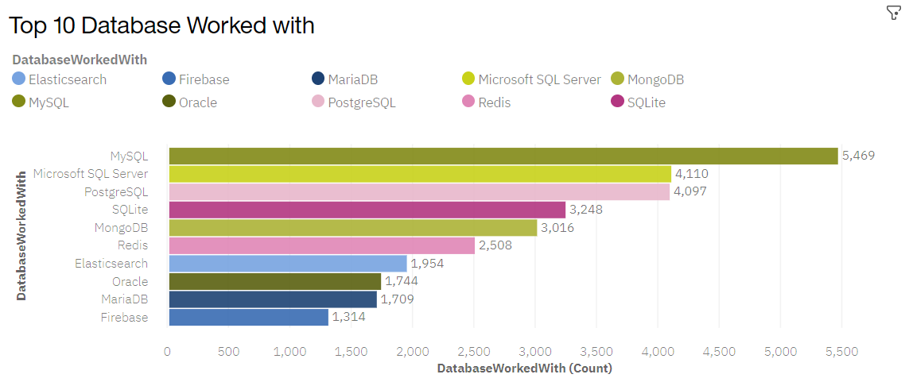
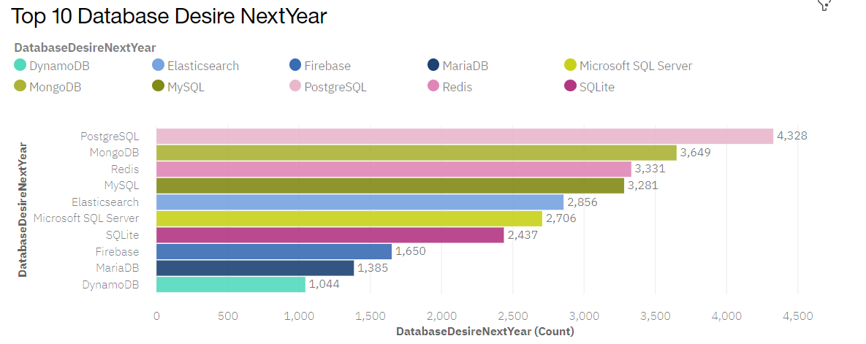
DATABASE TRENDS
Current Year
Next Year

Slide 10
DATABASE TRENDS - FINDINGS & IMPLICATIONS
Findings
RDMS have the highest trend in current usage
Non-relational database will the highest demand in future
Implications
People have high interest in learning non-relational database
Big data will be very popular in future.

Slide 11

DASHBOARD
https://dataplatform.cloud.ibm.com/dashboards/89a982ca-daae-4baa-8fbb-4de7f694fcc3/view/662ac20d1cac38c173fcc0e407cb7e0274637408bbbbd250d3817b490c677797f33c46c5c82d425b8b40546aa7ba130c9d

Slide 12
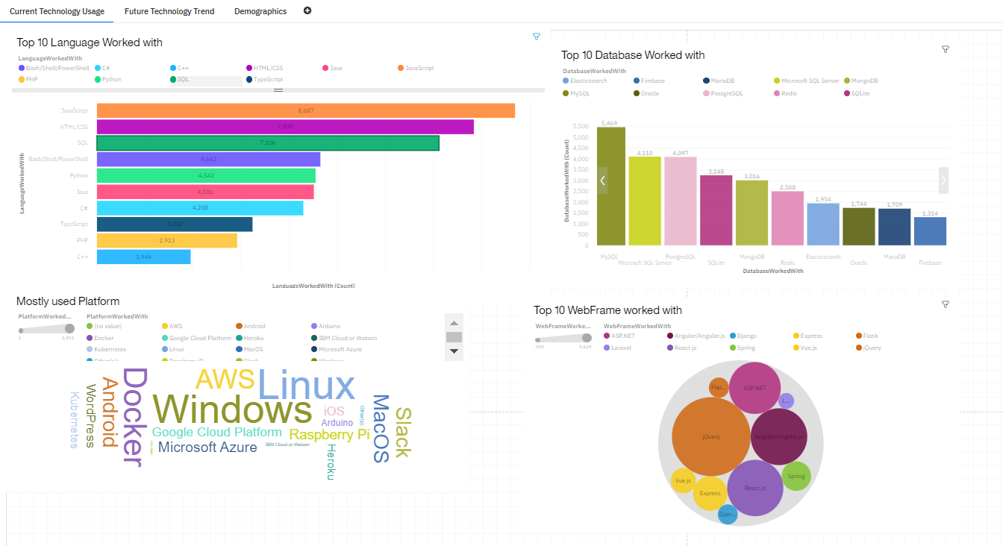
Current Technology Usage

Slide 13
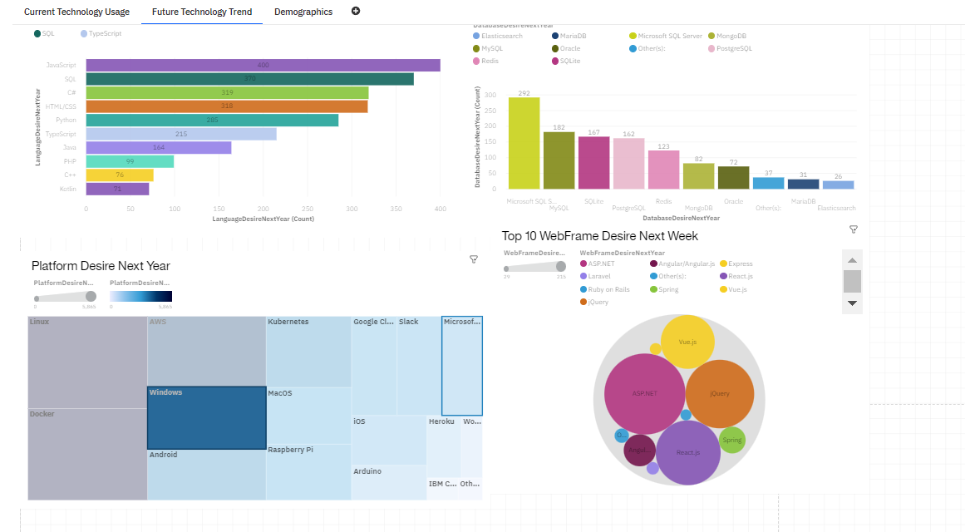
Future Technology Usage

Slide 14
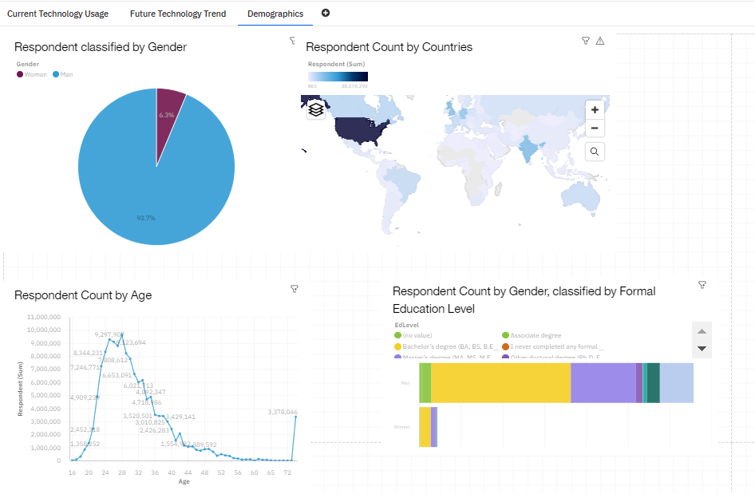
Demographic

Slide 15
DISCUSSION
Its clear from analysis that future is for big data so knowledge on big data with advanced programing language will make the difference.

Slide 16
OVERALL FINDINGS & IMPLICATIONS
Findings
People are preferring advanced programing language
Upcoming trend focus on non-relational database rather than relational DB.
Implications
Data is everywhere so everyone prefers big data.
People tends for easy programming languages.

Slide 17

CONCLUSION
Top programing languages are in demand.
The top database skills are in demand

Slide 18

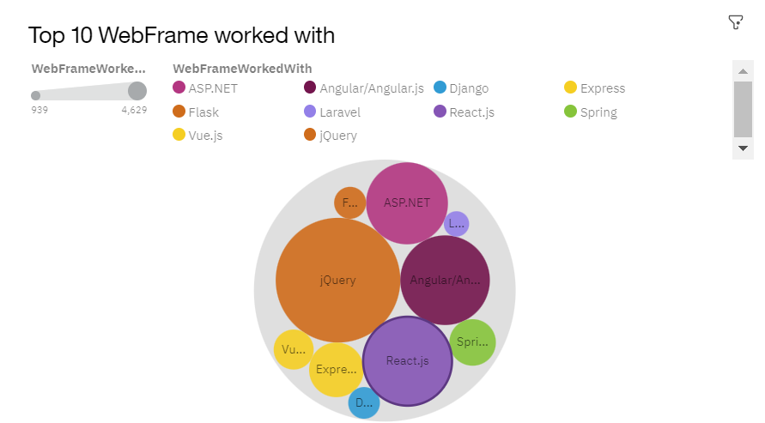
APPENDIX

